Slide 1


CHARUSAT, CSPIT- CE
U & P U. Patel Department of Computer Engineering
CE363 : PROJECT - III
Credit Card Fraud Detection
Research Using Unsupervised Learning
Prepared By: 22CE008 (Project ID: PRJ2024074)
Under Supervision of: Dr. Mrugendra Rahevar

Slide 2

Agenda Overview
01
Introduction
06
Comparative Study
02
Research Defination
07
Methodology
03
Scope and Objectives
08
Comparative Analysis
04
Literature Review
09
Summay of Findings
05
Dataset Overview
10
Future Work

Slide 3


Introduction
Fraud in Financial Transactions: Fraudulent activities in credit card transactions have become a major concern, resulting in billions of rupees in annual losses worldwide.
Dynamic Nature of Fraud: Fraudsters continuously evolve their methods, making traditional rule-based detection systems increasingly ineffective.
The Need for Advanced Techniques: Supervised learning methods require labelled data, which may not always be available or updated frequently enough.
Unsupervised Learning Approach: This project leverages clustering algorithms—DBSCAN, GMM, and K-means—to identify anomalies (potential fraud) in a real-world, unlabeled dataset.

Slide 4

Research Definition
Exploring the application of unsupervised learning algorithms—DBSCAN, GMM, and K-means—to detect fraudulent credit card transactions.
Problem Description:
Fraudulent transactions represent a small portion of all transactions.
Fraud patterns vary and adapt over time.
Manual detection is time-consuming and not feasible for real-time applications.
Need for adaptive and scalable systems for real-time fraud detection.

Slide 5
Scope and Objectives
Scope:
Using clustering algorithms to detect anomalies in a highly imbalanced dataset of credit card transactions.
Objectives:
Implement DBSCAN, GMM, and K-means on a credit card transaction dataset.
Evaluate clustering performance using metrics like silhouette score.
Identify the most effective model for real-time fraud detection.

Slide 6
Literature Review
Key Algorithms Explored:
DBSCAN (Density-Based Spatial Clustering of Applications with Noise):
Identifies dense regions and labels low-density points as noise.
Effective in detecting isolated fraudulent transactions.
Gaussian Mixture Model (GMM):
Uses a probabilistic approach to model clusters with different shapes.
Suitable for overlapping clusters where fraud patterns are less distinct.
K-means:
Groups data into K predefined clusters by minimizing within-cluster variance.
Serves as a baseline, though limited by its assumption of spherical clusters.

Slide 7
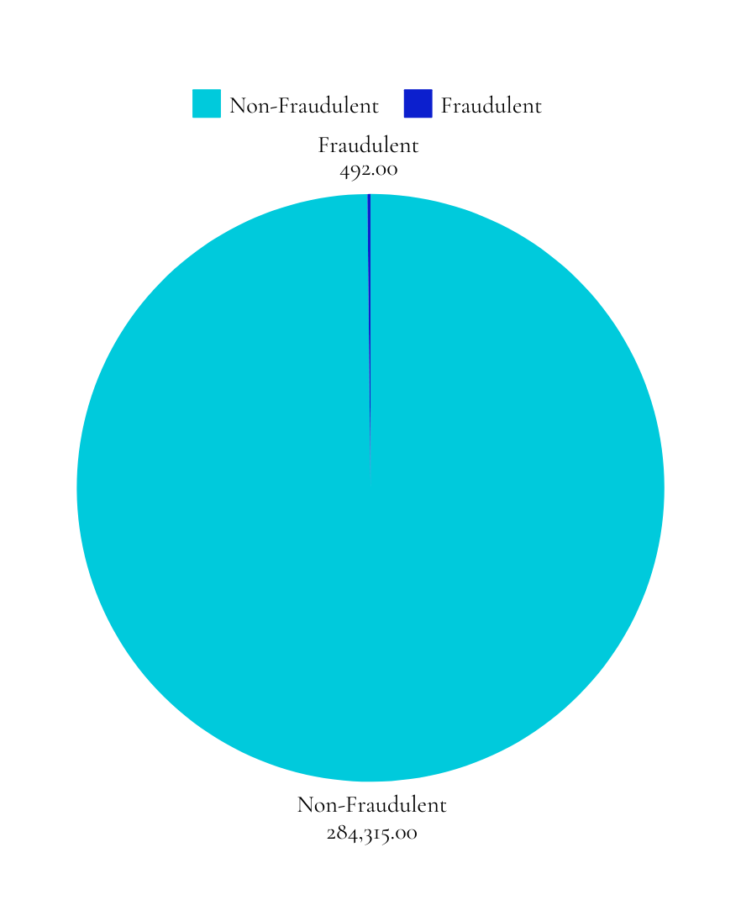
Dataset Overview
Source: Transactions by European cardholders (September 2013)
Total Transactions: 284,807
Fraudulent Transactions: 492 (0.172% of all transactions)

Slide 8
Comparative Study
Algorithm | Strengths | Weaknesses
DBSCAN | Detects noise effectively | Sensitive to ε and minPts
GMM | Handles overlapping clusters | Computationally expensive
K-means | Simple and fast | Assumes spherical clusters

Slide 9
Methodology
Dataset:
Publicly available dataset with 284,807 transactions and 31 features.
Includes both legitimate and fraudulent transactions.
Data Preprocessing:
Standardized Time and Amount with z-scores.
Ignored Class column to ensure unsupervised learning.
Used PCA to reduce dimensions.
Handled class imbalance through evaluation metrics.
Algorithm Implementation:
DBSCAN: Optimized parameters (ε, minPts).
GMM: Used Expectation-Maximization for probabilistic clustering.
K-means: Experimented with different K values.

Slide 10
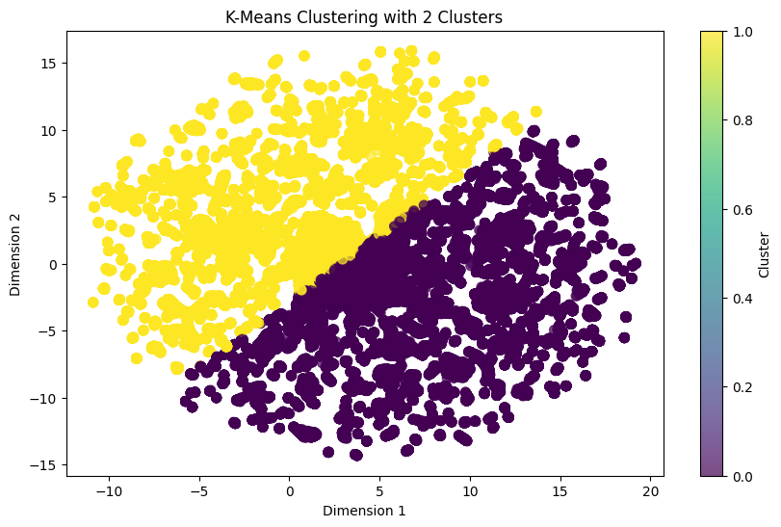
K-Means Clustering Results
Key Metrics:
Silhouette Score: 0.313
Observations:
Formed two clusters with moderate performance.
Overlap near cluster boundaries indicates challenges in separation.
Noise and outliers reduced accuracy in distinguishing fraudulent transactions.
Summary:
Moderate performance; centroid-based clustering struggles with noisy, overlapping data distributions.

Slide 11
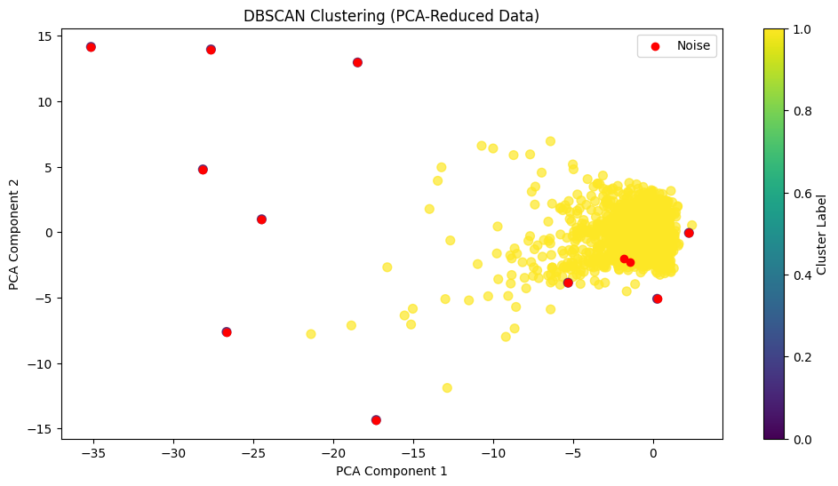
DBSCAN Clustering Results
Key Metrics:
Silhouette Score: 0.855
Adjusted Rand Index: 0.141
Davies-Bouldin Index: 2.284
Noise Points: 12
Observations:
Formed distinct, cohesive, and well-separated clusters.
Effectively excluded noise points (-1 cluster).
ARI misalignment reflects intrinsic data characteristics.
Summary:
DBSCAN excelled in handling noise and outliers, showcasing robust clustering performance.

Slide 12
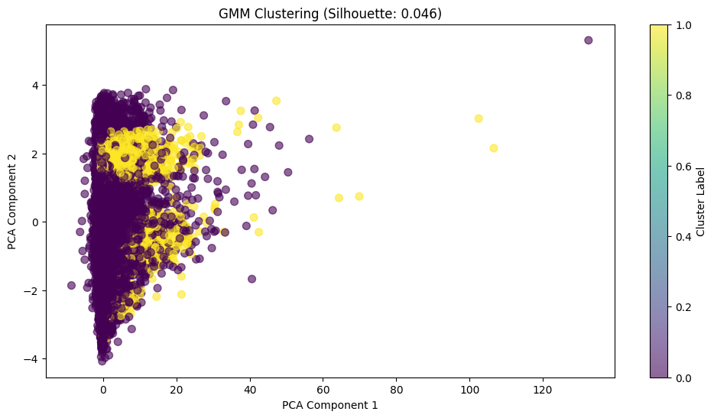
Gaussian Mixture Model (GMM) Results
Key Metrics:
Silhouette Score: 0.046
Adjusted Rand Index: -0.000
Davies-Bouldin Index: 4.587
Observations:
Poor cluster distinction with significant overlap.
High DBI reflects weak separation between clusters.
Summary:
GMM struggled with overlapping distributions; Gaussian assumptions were unsuitable for the dataset.

Slide 13
Comparative Analysis
Metric | K-Means | DBSCAN | GMM
Silhouette Score | 0.313 | 0.855 | 0.046
Adjusted Rand Index (ARI) | N/A | 0.141 | -0.000
Davies-Bouldin Index (DBI) | N/A | 2.284 | 4.587
Noise Handling | None | Good | Poor

Slide 14
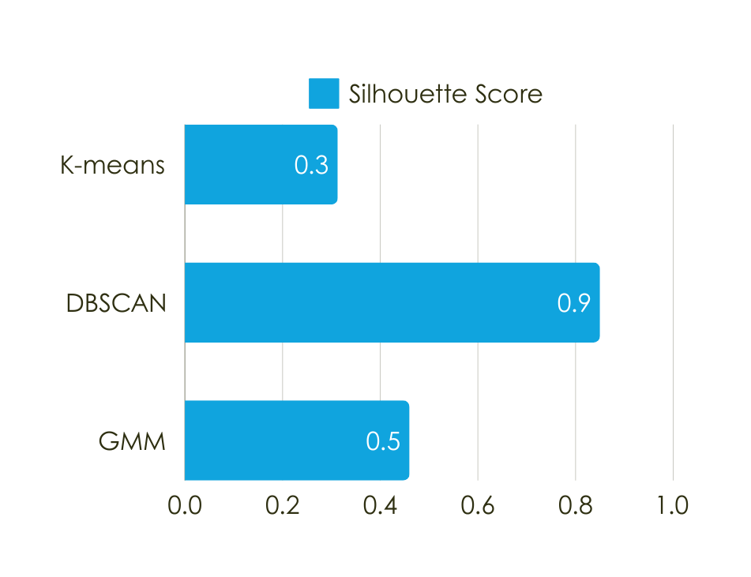
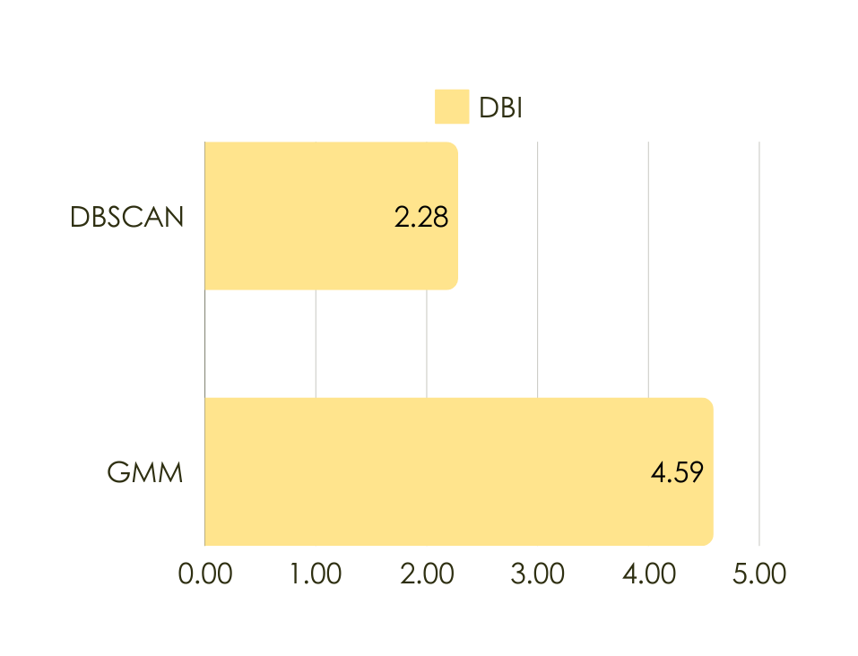
Comparative Analysis

Slide 15
Summary of Findings
DBSCAN:
Best clustering performance, excelling in handling noise and outliers.
High Silhouette Score (0.855) and average DBI (2.284).
K-Means:
Moderate performance, suitable for low-noise datasets.
Struggled with boundary points and noise.
GMM:
Poor performance on overlapping distributions.
Limited by its assumption of Gaussian clusters.
CONCLUSION:
DBSCAN is the most suitable method for this dataset and similar fraud detection tasks.
For further optimization it can be done through feature engineering or hybrid clustering approaches for enhanced results.

Slide 16
Future Work
Explore hybrid models combining supervised and unsupervised learning.
Test algorithms on larger and more complex datasets.
Develop real-time fraud detection systems using DBSCAN.

Slide 17


Thank You

